Slide 1

Introduction to Computer Science Using R: A Course for Analysts
Lesson 2: R Fundamentals

Slide 2
References & Texts
I recommend the following resources, which I have made copious use of in developing this material:
Paul D. Crutcher, Neeraj Kumar Singh, and Peter Tiegs
Essential Computer Science, A Programmer’s Guide to Foundational Concepts
APress / Springer Nature, 2021 https://doi.org/10.1007/978-1-4842-7107-0
Garrett Grolemund
Hands On Programming in R
O'Reilly and Associates, 2014 http://bit.ly/HandsOnR
Homer White
Beginning Computer Science with R
Georgetown College https://homerhanumat.github.io/r-notes/index.html

Slide 3
Our First R Notebooks

Slide 4
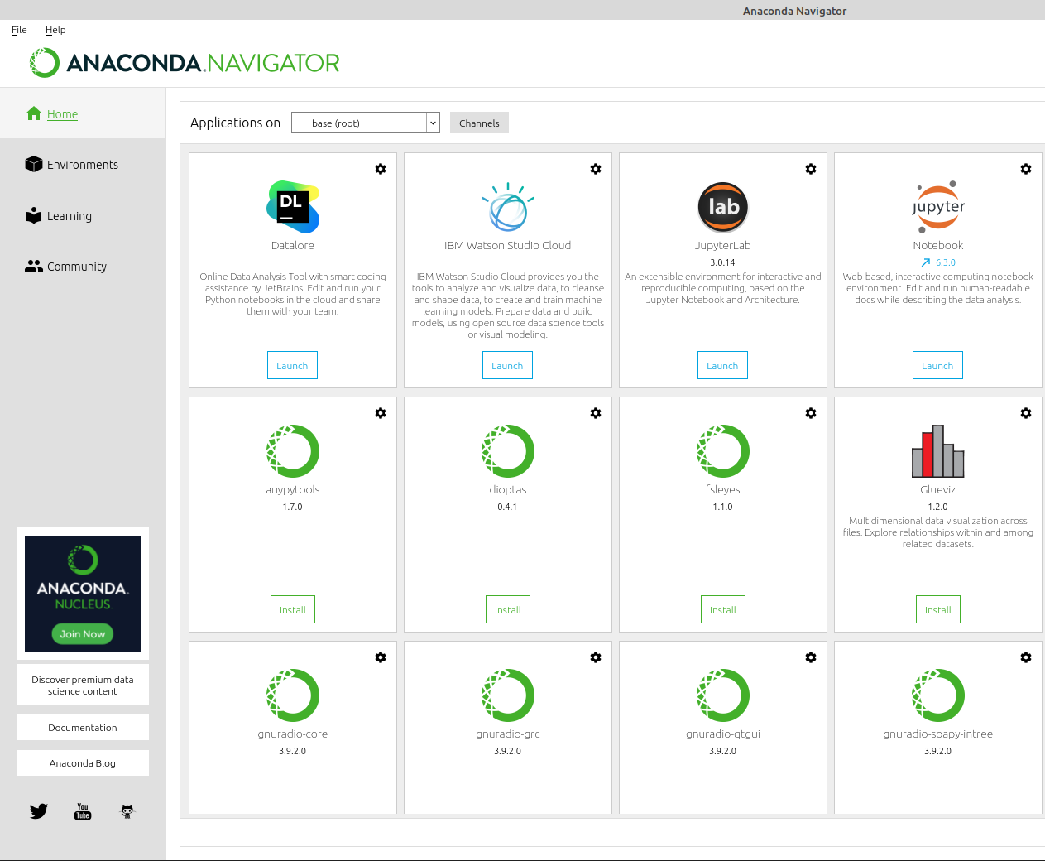
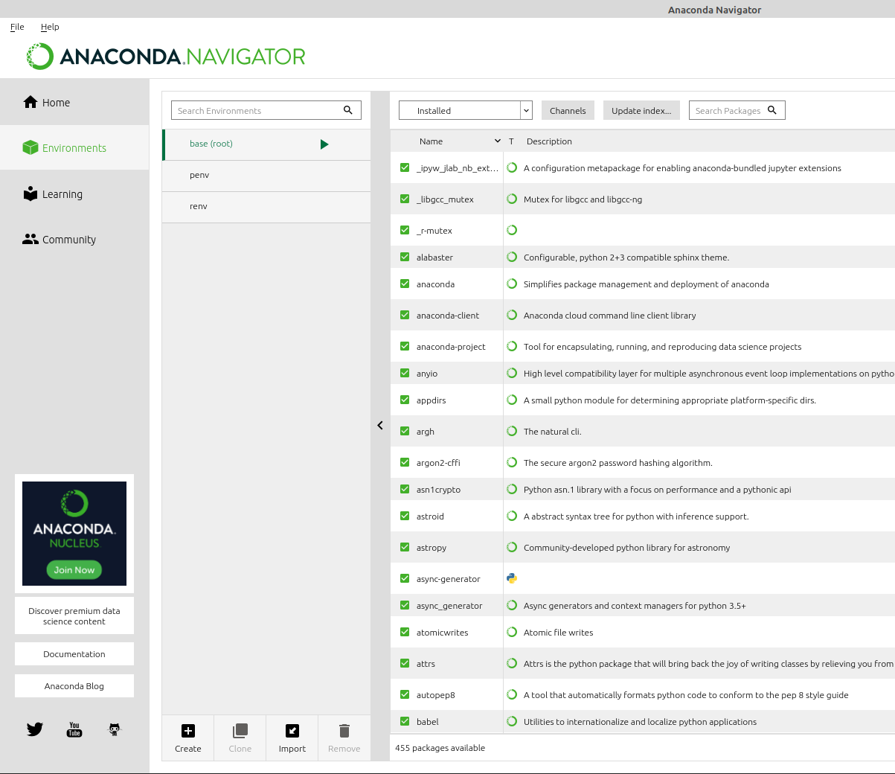


Once you've started Anaconda in your environment, I recommend creating an R-specific environment for your R coding.
You'll see the screen on the left.
Click the tab labelled "Environments", then at the bottom of that screen, Click "Create". Enable it for both Python and R. Name your R environment and save it. Mine is called 'renv' (not very creative).

Slide 5
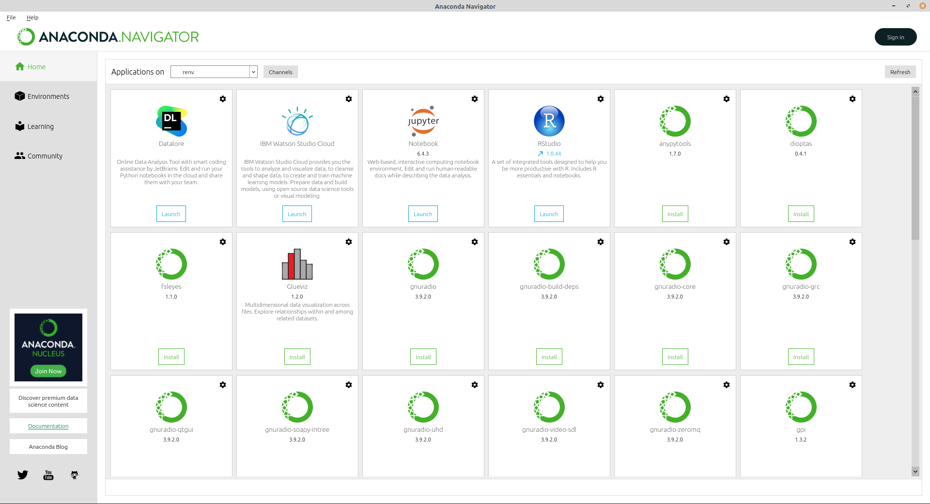

Then, restart Anaconda, and when the home screen loads, choose your new R environment from the dropdown menu.
Click Install under both Jupyter Notebooks and R Studio.
(The advantage of having a dedicated R environment is when you are running your R programs in it, it isolates them from the rest of your system.
This is handy when you try to run some machine learning or statistics modeling code that ends up using a lot of memory. You'll be able to stop the process without bringing down your system.)

Slide 6
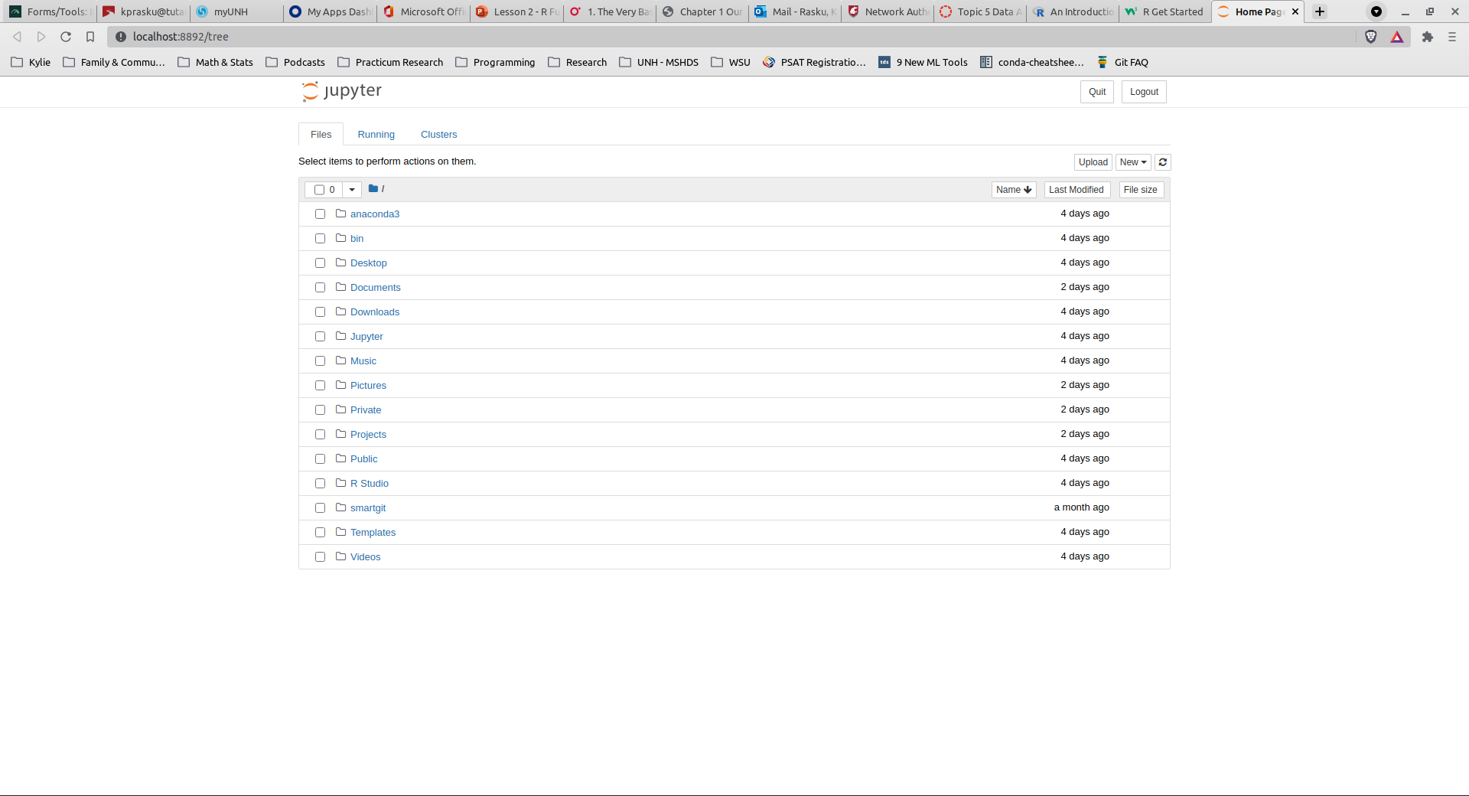

Once you have your R environment set up and Jupyter & R Studio installed, you can Launch Jupyter from your R environment in Anaconda Navigator.
Once it launches, you'll see the screen below in your web browser.

Slide 7

The tool launches in your home folder.
You can create a directory there to hold code, such as a "bin" directory, or one that holds "Projects", etc.
Click the blue text to navigate through the folders to your notebooks. Notebook files have the suffix .ipynb
I have a "Projects" directory that houses all my local GitHub repositories. I use Git for version control. If you don't know Git and want to learn, I recommend viewing the video tutorials at
https://www.git-tower.com/learn/

Slide 8
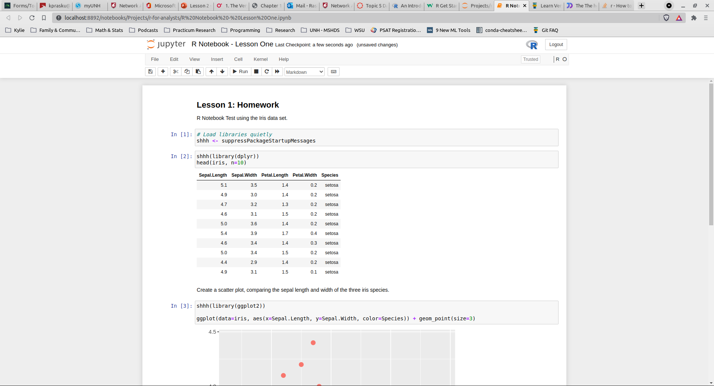
Homework One Review

Slide 9
Interactive R

Slide 10
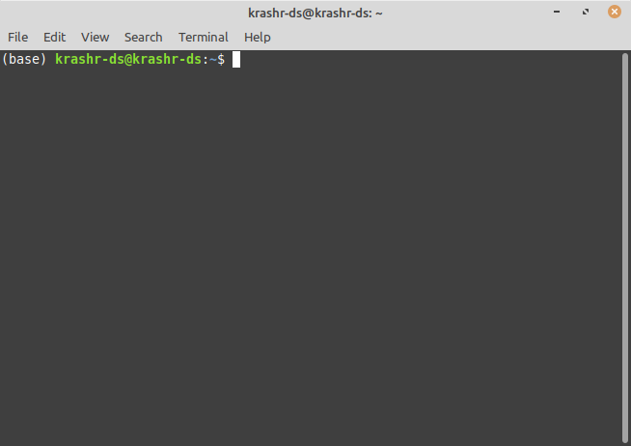
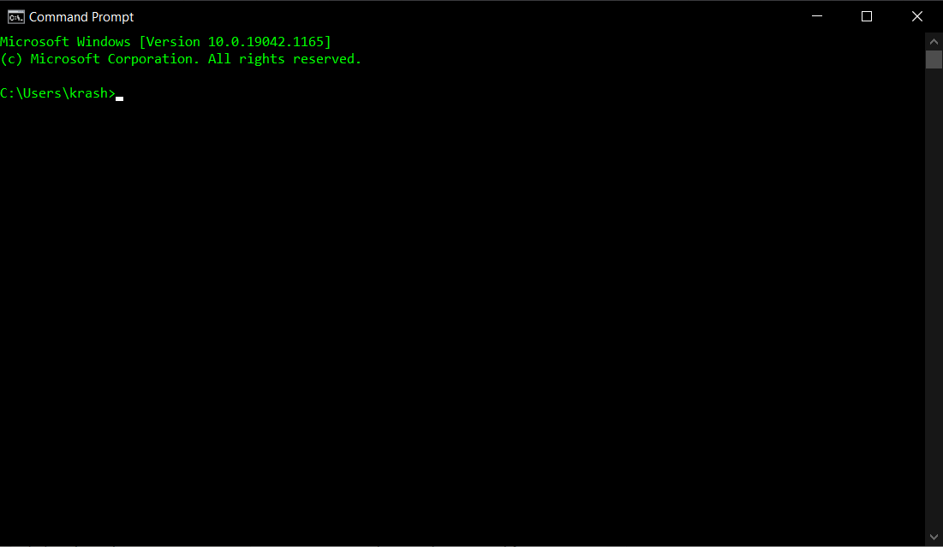
The Command Line
If you've only ever interacted with a computer through a graphical interface, you may not know there is such a thing.
But if you've ever opened up a Command Prompt in Windows or on your Mac (or if you use Linux), you may have seen a screen that looks like this.
The little white box that flashes is called the prompt or cursor. It is inviting you to type something the computer will understand.
Programmers call this interface the Command Line.

Slide 11
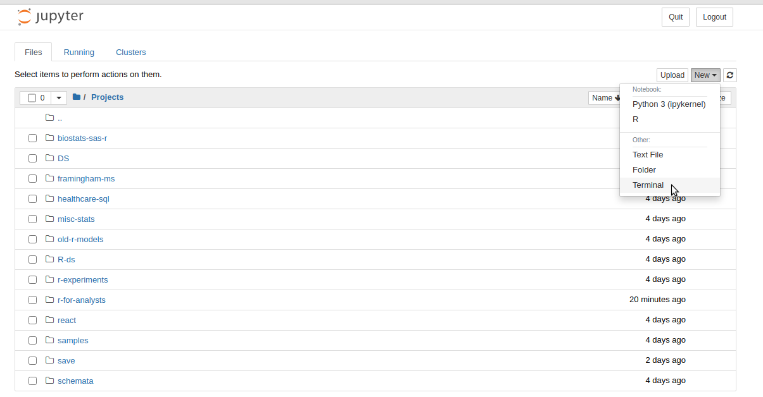

Using conda at the Command Line
You can access your contained conda environment for R at the command line too.
If you have Linux, you can set this to activate by default – note the prefix (base) appears before my regular Linux prompt at the right.
If you use Windows, you can access a conda-contained environment via Jupyter Notebooks by clicking New > Terminal at the folders view / start up screen.

Slide 12
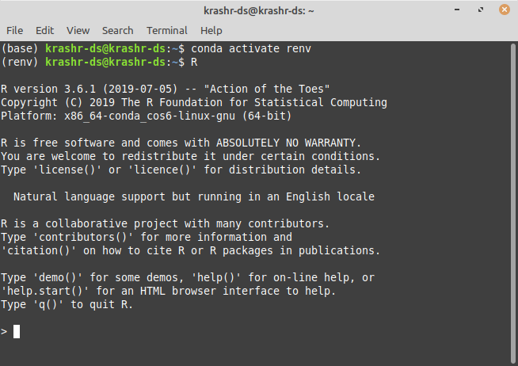
Activate your environment, and start R
Once your terminal is up, type:
conda activate renv
at the prompt, substituting the name you chose for your R environment for 'renv'.
Then, start the R interactive command line interface. If you're on Windows, you'll type:
Rterm.exe
On Linux or the Mac, you'll type:
R

Slide 13
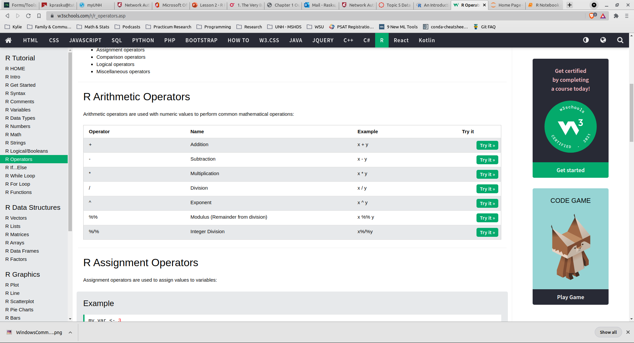
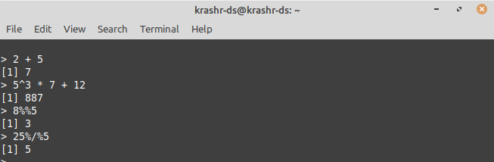
Learn Operators: try some math
As we established in Lesson One, computers love math and all programming languages allow for quick & easy math operations, especially the basic ones!
R is no exception.
Try some math at the command line using familiar operators like * (multiplication), / (division), + (addition) and - (subtraction).
Then try some others:
%% (modulus): does division and gives you the remainder
%/% (integer division) and
^ (exponentiation)

Slide 14


Nerd Moment: This interactive action at the command line has a name! It's called "the Read-Evaluate-Print-Loop", or REPL for short. R is one of many languages that allows interactive computations in the console. This allows us to run a small procedure, check results and then try something else. REPL makes it easy to see what R is doing and to get immediate feedback!

Slide 15
Variables and More Operators

Slide 16

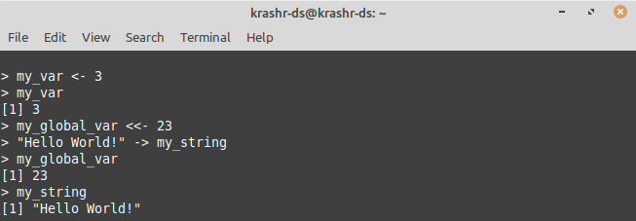


Variables: Storing Stuff in Memory
Declaring variables in R
The assignment operators
<- and ->
<<-
Scope?

Slide 17
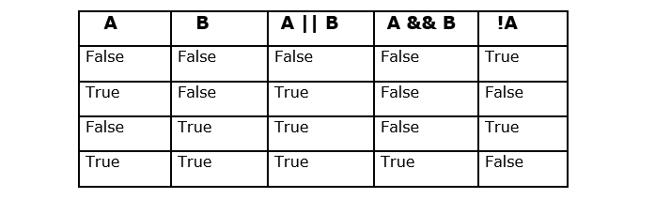
Homework – Week 2
Variables & Operators
1. Log in to your conda R environment via the command line.
2. Play around with the interactive console.
3. Declare some variables using "var" and the assignment operator <-
4. Go to this W3Schools Link, and try out all the operators listed under
* R Comparison Operators
* R Logical Operators
And * R Miscellaneous Operators
5. Take screen captures of your console windows and save them
6. As usual, reach out to me with any questions or issues!
7. Next week there will be a short quiz on logical operators
8. The study guide is in the upper right-hand corner

